Slide 1


BUA 751 : Machine Learning for Business
Chenna Keshav Chinthakindi
Uday Suhas Nakkapalli
Meghanath Somarowthu
Sai Sinduri Vangala
Medical Analysis
Professor: Donald Harter

Slide 2

Part 1 : Visualization

Slide 3

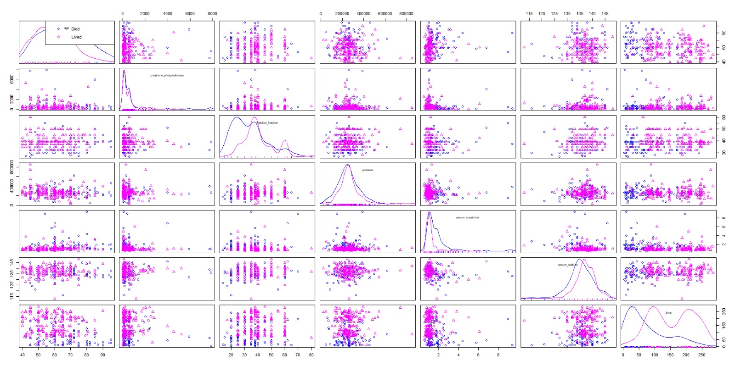
Visualization
We see that there is a significant degree of data fluctuation in this scatterplot matrix. But, we can see a pattern where there is a clear division between the death events' occurrences, particularly on the time column. In other words, when the follow-up period is shorter, deaths occur more frequently, and when it is longer, people usually survive.

Slide 4
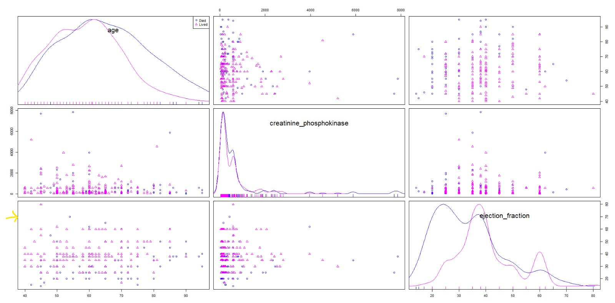

Age VS Ejection Fraction
In this figure, it is evident that a person has a higher likelihood of dying when both age and ejection fraction are low, but not when they are both higher.

Slide 5
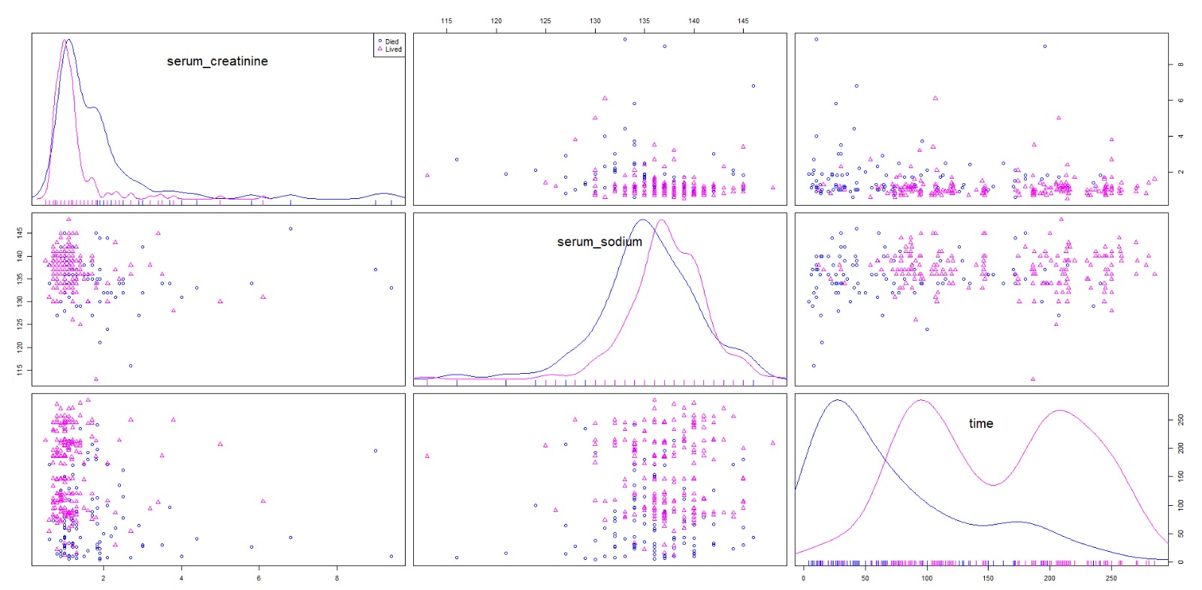
Serum Creatinine VS Time
In this diagram, we can see that there is a higher risk of mortality when the patient does not regularly follow up and has a low serum creatinine level. But, the likelihood of survival rises with increased follow-up.

Slide 6
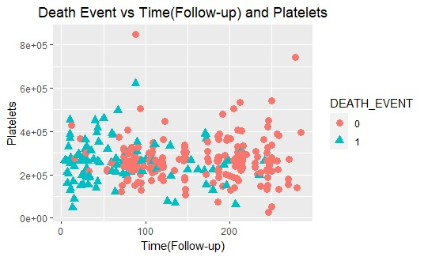
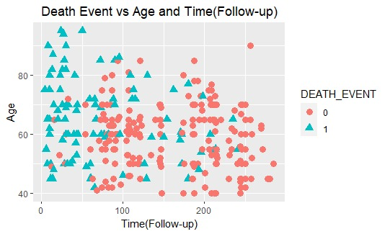
Graphs with pairs of continuous variables and plotted with Death events

Slide 7
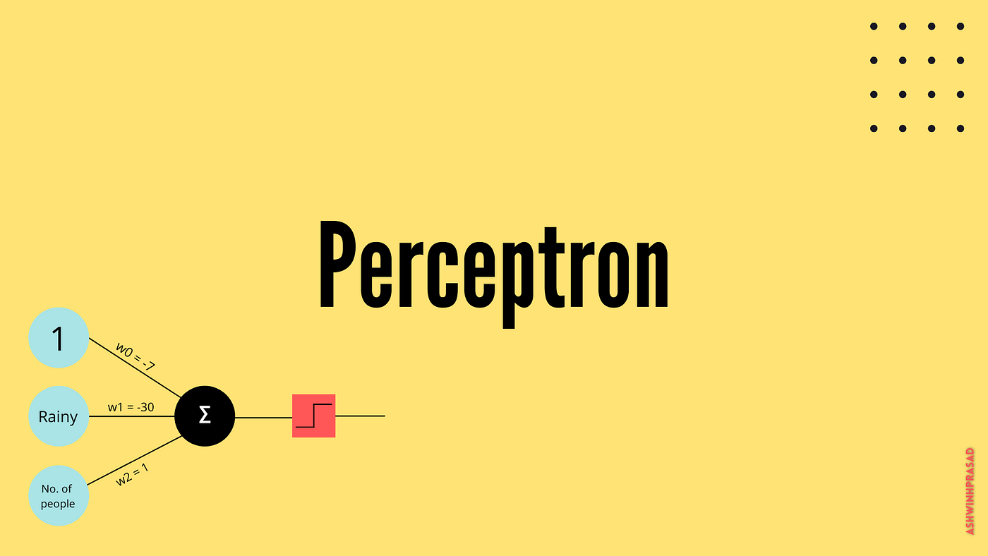
Part B:

Slide 8

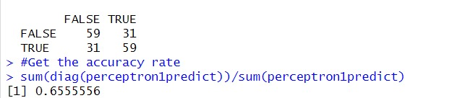
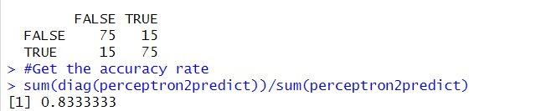
Part 2 : Perceptrons
From this model we can observe that Age and Time are better predictors for our model, so we should consider them for future calculations.
Age and Serum Sodium
Accuracy – 65.55%
Age and Time
Accuracy – 83.33%

Slide 9
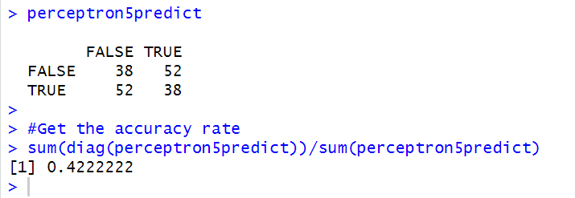
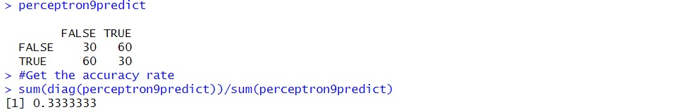
Part 2 : Perceptrons
Age and Ejection Fraction and Time
Accuracy – 42.2%
Age and Ejection Fraction and Serum_Sodium
Accuracy – 33.33%

Slide 10

Part 2 : Perceptrons
With an accuracy of 88.33%, Age and Time were the superior predictors when Perceptron was ran with just two variables.
Age, Ejection Fraction, and Platelets shown to be the superior predictors with an accuracy of 42.2% when Perceptron was performed with three variables.

Slide 11
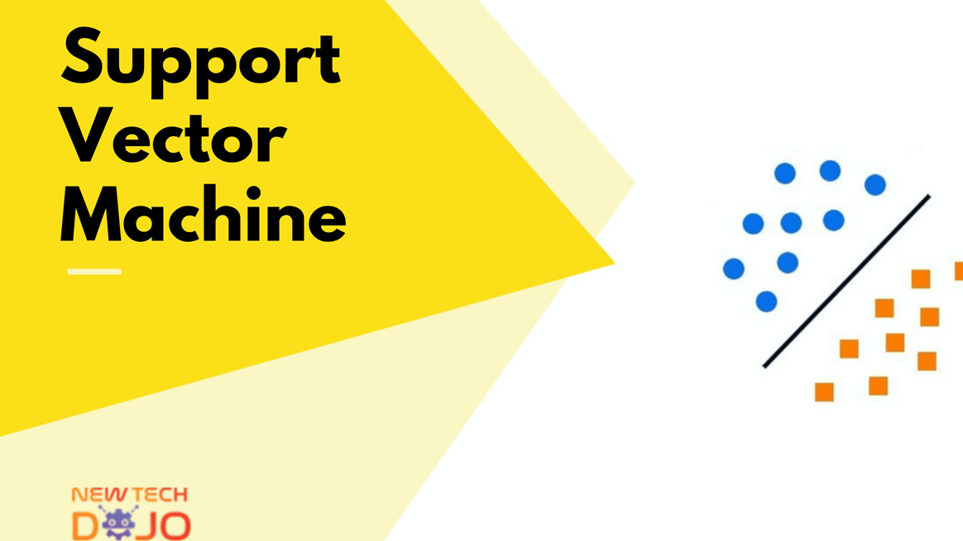
Part-C

Slide 12
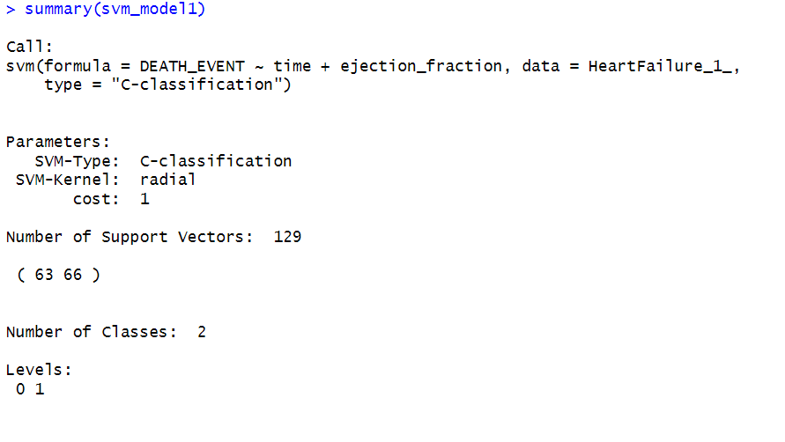
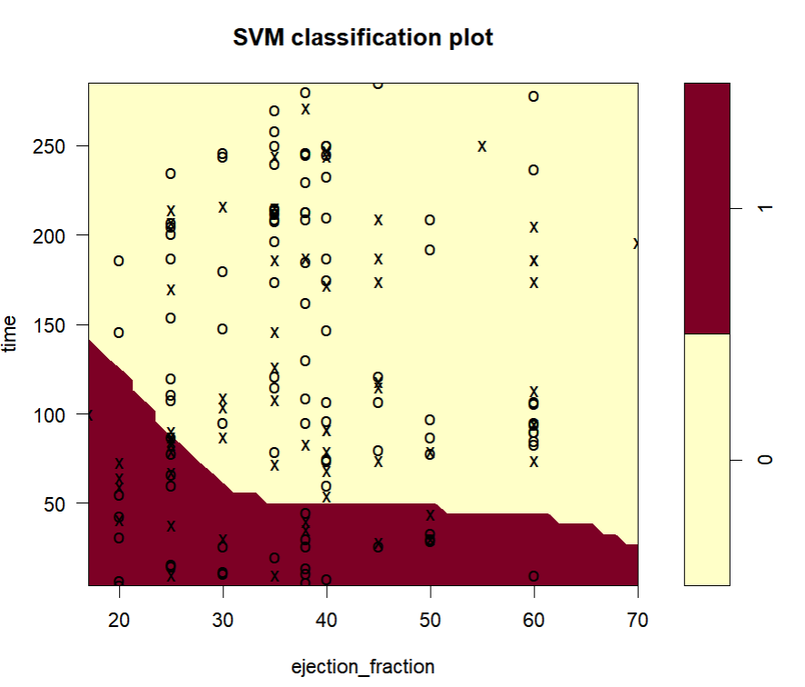
SVM Model_1 (2 Variable)
Death Event VS Time and Ejection Fraction

Slide 13
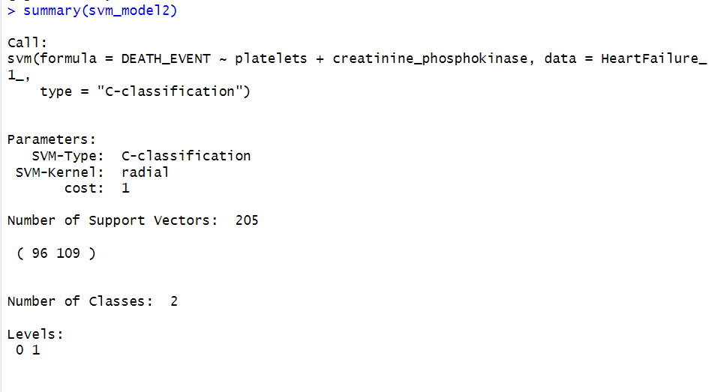
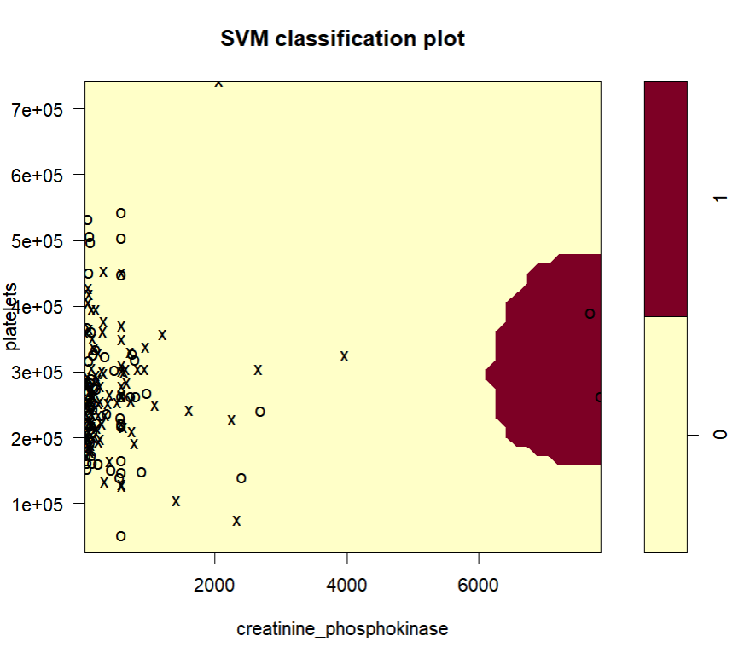
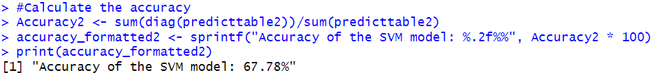
SVM Model_2 (2 Variable)
Death Event VS Platelets and Creatinine Phosphokinase

Slide 14
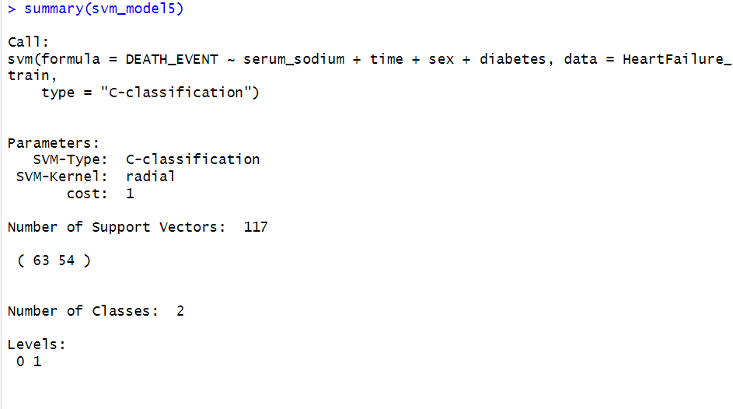
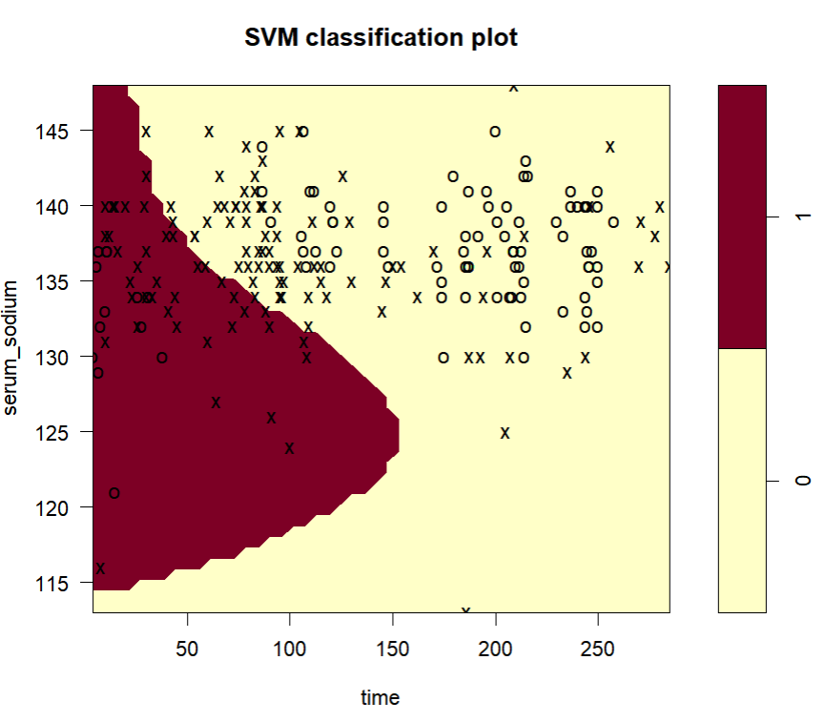
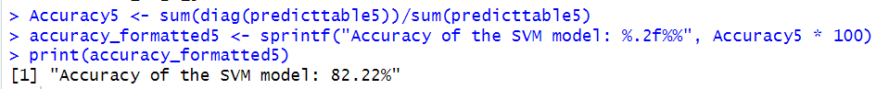
SVM Model_3 (>3 Variable)
Death Event VS Time and Serum Sodium for Males with No Diabetes

Slide 15
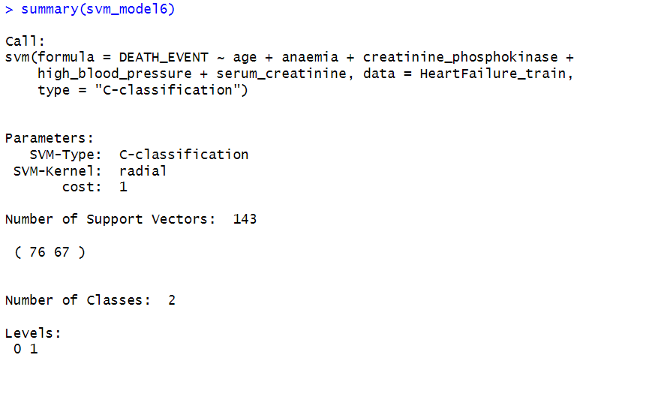
SVM Model_4 (>3 Variable)
Death Event VS Serum Creatinine and Creatinine Phosphokinase for People of age 50 who are also suffering with High blood pressure and Anaemia

Slide 16
SVM Model - Summary
When SVM is run with 2 variables, time and Ejection fraction (Chosen because they have the highest correlation strength with Death Event) Gave me the highest accuracy of 86.67%
When SVM is run with three variables Platelets and creatinine phosphokinase(least correlated with death event) the accuracy was 67.78%
When SVM is run with 4 variables, Time, Serum sodium, Sex and Diabetes (Where all 4 variables are negatively correlated with death Event) accuracy came out to be 82.22%.
When SVM is run with 5 variables, Serum Creatinine , Creatinine Phosphokinase, Age, High blood pressure and Anaemia accuracy(Where all variables are positively correlated) came out to be 72.22%.

Slide 17

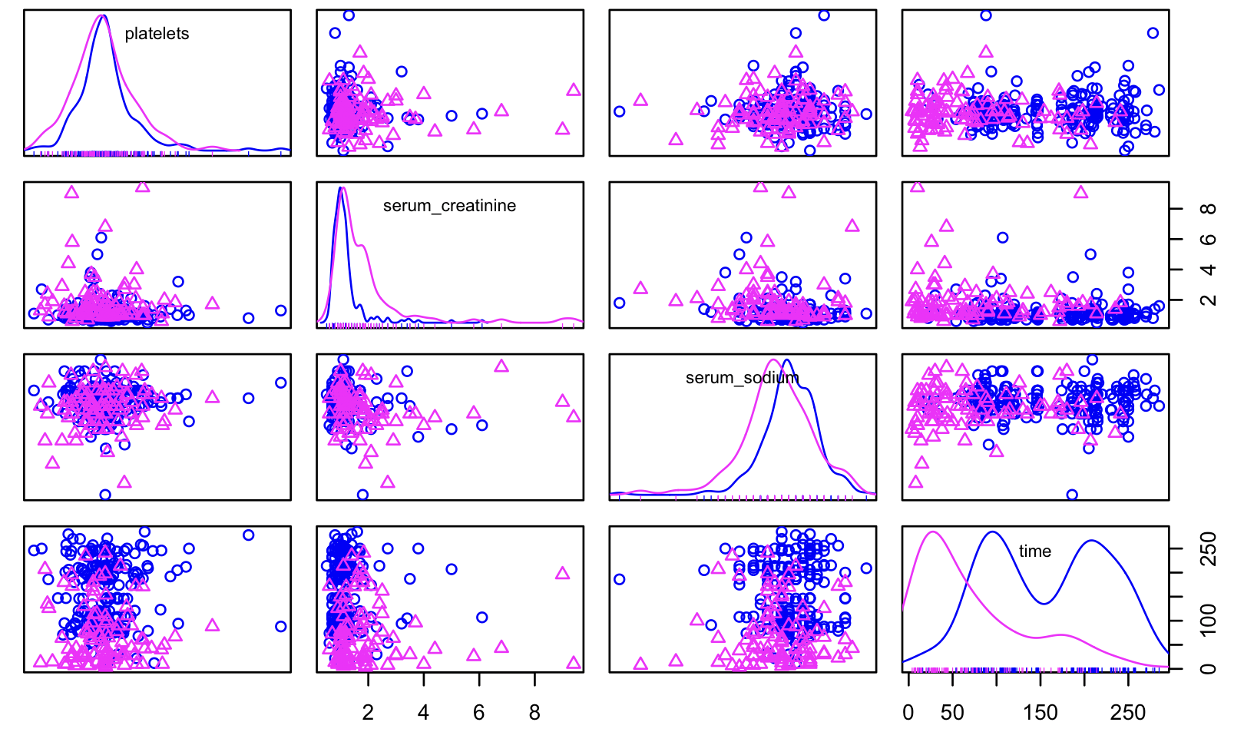
Part 4:
Visualization are particularly valuable when the data points can be grouped into distinct clusters.
In our dataset since there is a lot of noise it wasn’t very clear which variables, when selected were good predictors for out dependent variable. For example, Platelets vs Serum Sodium.

Slide 18


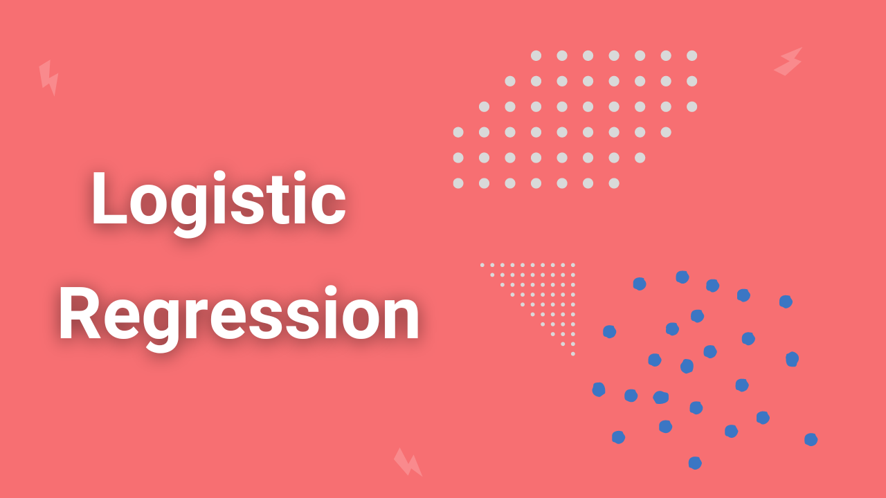
Which Technique Worked ?
Which Did Not ?
Why ?
We observed that SVM model worked better than perceptron, because SVM can handle non-linear relationships when separating relevant groups. SVM is less sensitive to outliers than perceptron.
Support vector machines
What other Techniques could be Used

Slide 19



